Slide 1
Adversarial examples of Neural Networks
Spring 2018
UROP: Karunya Sethuraman, Mentor: Lily Weng, Advisor: Luca Daniel
MIT EECS

Slide 2
Introductions/Motivations
Try to summarize from the introductions of the papers

Slide 3
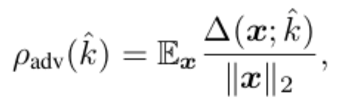
How DeepFool works
Deep neural networks are particularly unstable to adversarial perturbations
Adversarial perturbation = minimal perturbation r sufficient to change the label k(x)
Oftentimes perturbed image looks visually similar to original image
The robustness for an image x can be can be calculated as follows:
A classifier’s robustness is therefore:

Slide 4

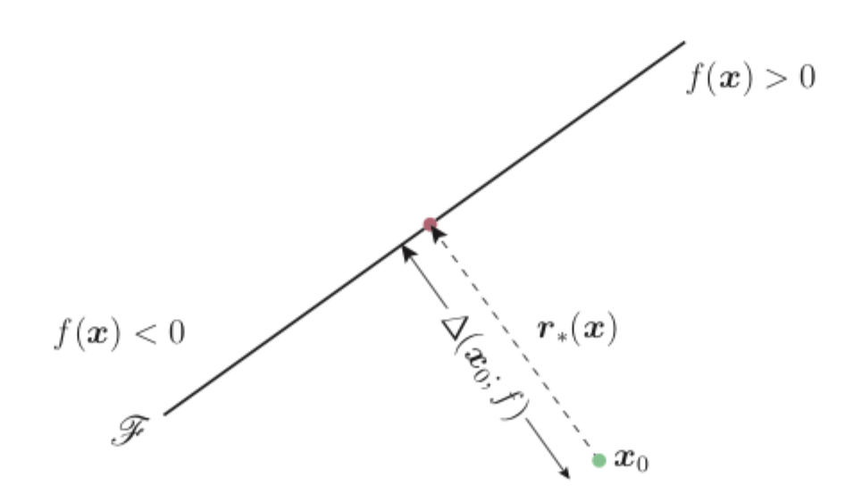
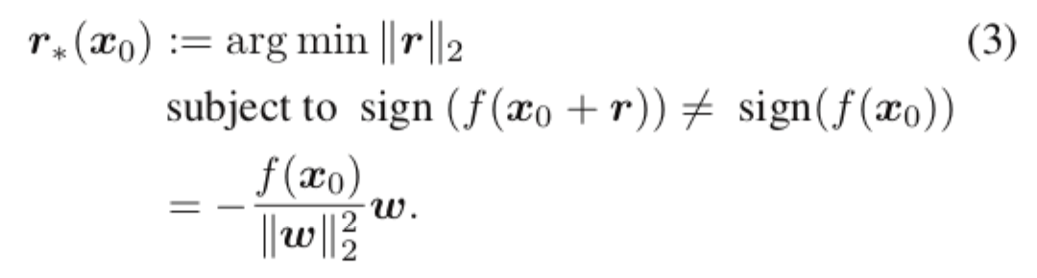
DeepFool cont’
Adversarial perturbations presented here are more reliable and efficient, avoiding misleading conclusions about robustness and leading to a more robust classifier
DeepFool for Affine Binary Classifiers
Assume where

Slide 5
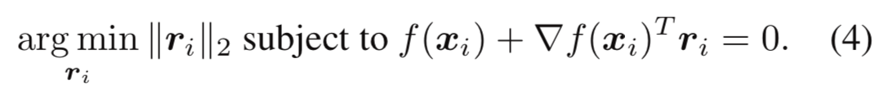
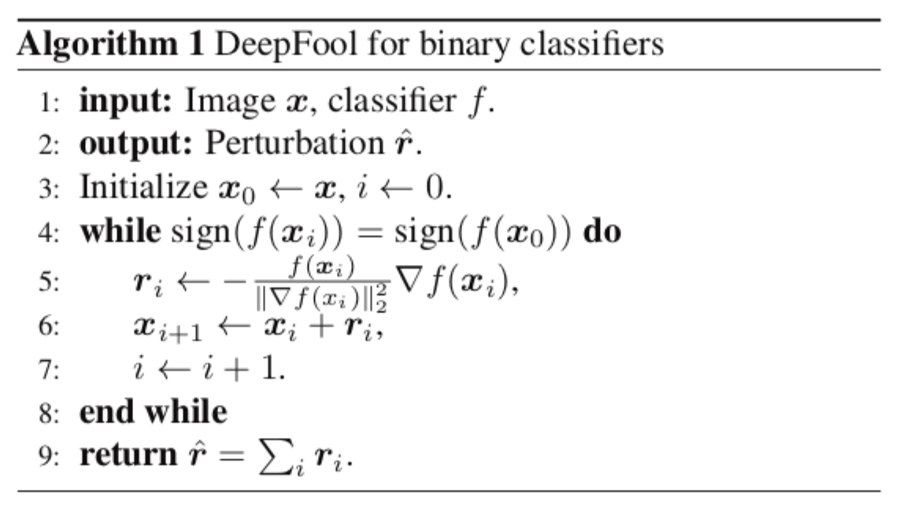
DeepFool for Binary Classifiers
Used step size of 0.02, step size should be << 1
Uses r to update x_i+1 from x_i
Algorithm terminates when x_i+1 changes the sign of the classifier

Slide 6

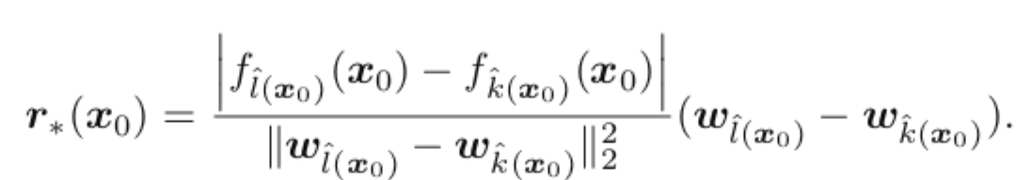
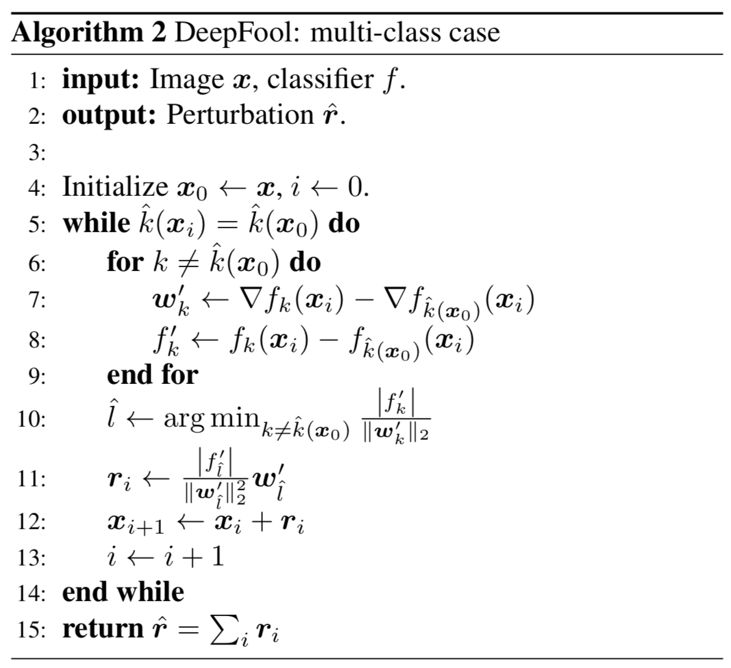
DeepFool for Multiclass Classifiers
Closest projection of x_0 on the boundary polyhedron

Slide 7
Pros and Cons
Computationally more efficient
Not necessarily guaranteed to always change image (?)
Doesn’t guarantee minimal perturbation, but pretty small distortion comparatively

Slide 8
Revised deep fool code by
Using p_inf (already in code)
Adding functions to calculate distortion
to do for this week

Slide 9
What are the models used with Deep Fool?
2 layer nn trained on MNIST
3 layer nn trained on MNIST
Parameters
200 hidden units, lr = 1e-3, 20 epochs
Training
used above parameters
Accuracy on test set (MNIST)
98%
Parameters
300 and 100 hidden units, lr = 1e-4, 10 epochs
need to tune more
Training
used above parameters
Accuracy on test set (MNIST)
98%
Notes:
Maybe switch elu? Relu is best? Leaky relu?

Slide 10
How did the adversarial distortion work
Have a table like slide 16 or image

Slide 11
Methods Summary
1. DeepFool
2. Fast Gradient Sign Method (FGSM)
Idea:
Paper:
A simple and accurate method to fool deep neural networks
https://arxiv.org/abs/1511.04599
Code:
https://github.com/LTS4/DeepFool
Pytorch
Idea:
Paper:
Explaining and Harnessing Adversarial Examples
https://arxiv.org/abs/1412.6572
Code:
https://github.com/gongzhitaao/tensorflow-adversarial
Tensorflow

Slide 12
Methods Summary
3. Iterative FGSM
4. Carlini Wagner Attack
Idea:
Paper:
Adversarial examples in the physical world
https://arxiv.org/abs/1607.02533
Code:
https://github.com/gongzhitaao/tensorflow-adversarial
Write codes based on FGSM
Tensorflow
Idea:
Paper:
Towards Evaluating the Robustness of Neural Networks
https://arxiv.org/abs/1608.04644
Code
https://github.com/gongzhitaao/tensorflow-adversarial
Tensorflow

Slide 13
Method 1: DeepFool (Instructions)
1. Summarize important and basic ideas in the slides
2. Write down pipeline of designing an adversarial example
1. How does it work
2. Try to think of 1-2 pros and cons of this method
3. Any ideas to possibly improve this method?
This will help you familiarize with current state-of-the-art methods
For the very first two times, detail in slides how you do Step 1 and Step 2 (see next page).
Then, summarize the words/numbers (green box, see next page) into tables and show in slides
If you encounter any problems, try to summarize them in slides too
This will help you familiarize with the standard pipelines

Slide 14
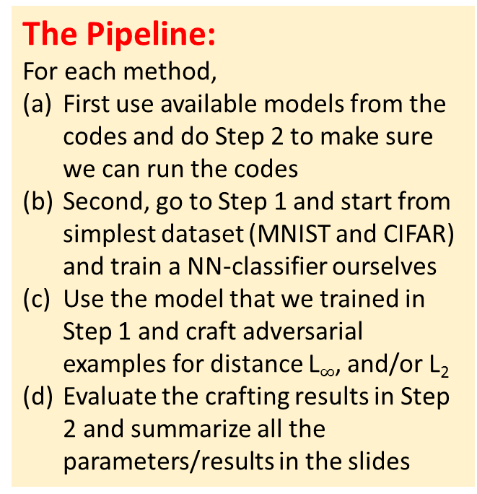
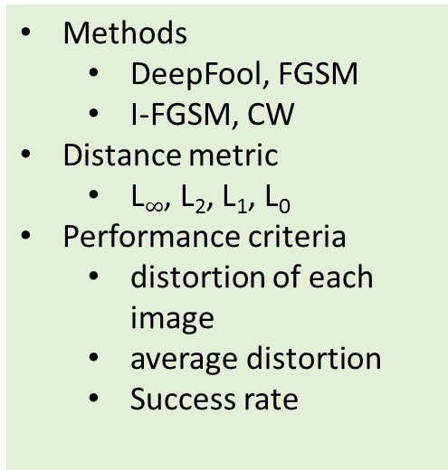
Method 1: DeepFool (Instructions)
Step 1. Train a neural network classifier on a dataset
Step 2. Craft adversarial examples via methods 1-4
The Pipeline:
For each method,
First use available models from the codes and do Step 2 to make sure we can run the codes
Second, go to Step 1 and start from simplest dataset (MNIST and CIFAR) and train a NN-classifier ourselves
Use the model that we trained in Step 1 and craft adversarial examples for distance L$∞$, and/or L₂
Evaluate the crafting results in Step 2 and summarize all the parameters/results in the slides
Dataset
mnist, cifar, imagenet
Network architecture
MLP, CNN, ResNet
# of layers, neurons
Activation function
Packages
Tensorflow, pytorch
Machine
CPU, GPU spec
Training algorithms
SGD, learning rate, epochs
Performance criteria
Test set accuracy
Methods
DeepFool, FGSM
I-FGSM, CW
Distance metric
L$∞$, L₂, L₁, L₀
Performance criteria
distortion of each image
average distortion
Success rate

Slide 15
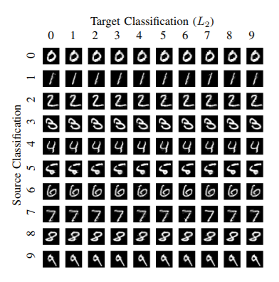
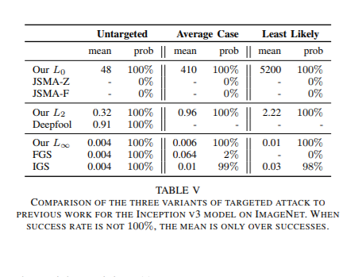
Result presentation example (final presentation of this semester’s result)
1. Visual illustration
2. Quantitative analysis
Average distortion, success rate, etc

Slide 16
Method 2: FGSM

Slide 17
Method 3: I-FGSM

Slide 18
Method 4: CW

Slide 19
Tentative Agenda
 | Topic | Expectation
02.21 | Intro DeepFool | -
02.28 with Luca | DeepFool | Understand the motivation and idea of deepfool and get codes running
03.07 | DeepFool | Build-up the pipeline of step 1: train a NN on mnist/cifar
03.14 with Luca | DeepFool | Build-up the pipeline of step 2: craft adversarial example and show results
03.21 | FGSM, I-FGSM | Discuss the idea of FGSM/I-FGSM and get initial codes running
03.28 | Spring break
04.04 with Luca | FGSM, I-FGSM | craft adversarial example and show results
04.11 | C&W | Discuss the idea of C&W and get initial codes running
04.18 | C&W | craft adversarial example and show results
04.25 with Luca | C&W | Show the results of crafted example and compared with other methods
05.02 | Lily traveling
05.09 | Final presentation | Present what is learned/achieved in this semester

